Slide 1
transitivity and clustering coefficients

Slide 2
Modeling Real World Networks with Graphs
A network structure is modeled as a graph or directed graph, often with labels assigned to nodes or edges. Such a graph is expected to mimic the properties of the network: connectivity, distances between nodes, degree distributions, etc.
Questions about underlying graphs
Do they have any common properties? If so, what are those properties?
How arbitrary can they be? Does any graph can be the underlying graph of a real-world network?

Slide 3
Random Graphs

Slide 4
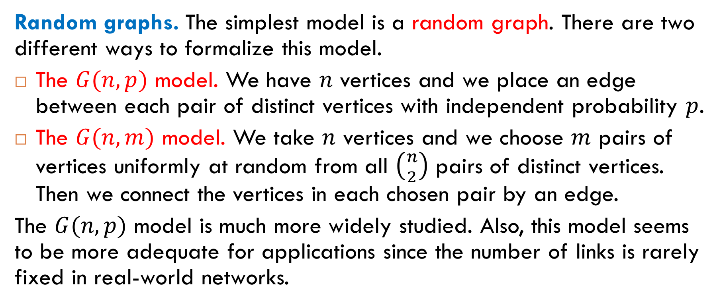
Two Random Graph Models
Random graphs. The simplest model is a random graph. There are two different ways to formalize this model.
The $G(n,p)$ model. We have $n$ vertices and we place an edge between each pair of distinct vertices with independent probability $p$.
The $G(n,m)$ model. We take $n$ vertices and we choose $m$ pairs of vertices uniformly at random from all $\left({n \atop 2}\right)$ pairs of distinct vertices. Then we connect the vertices in each chosen pair by an edge.
The $G(n,p)$ model is much more widely studied. Also, this model seems to be more adequate for applications since the number of links is rarely fixed in real-world networks.

Slide 5
Example
Two realizations of a random graph with $n = 12$ and $p =1/6$.

Slide 6
Another Example
Three realizations of a random graph with $n = 100$ and $p =0.03$.

Slide 7
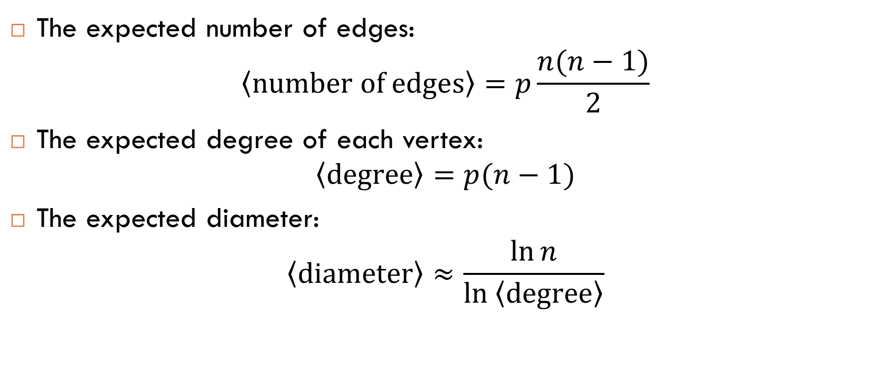
Some Expectations for Random Graphs
The expected number of edges:
$$\left\langle \text{number} \text{of} \text{edges}\right\rangle =p\frac{n(n−1)}{2}$$
The expected degree of each vertex:
$$\left\langle \text{degree}\right\rangle =p(n−1)$$
The expected diameter:
$$\left\langle \text{diameter}\right\rangle ≈\frac{\ln{n}}{\ln\left\langle \text{degree}\right\rangle }$$

Slide 8
Are Real-World Networks Random?
Question
Are random graphs good models of real-world networks?
Answer
No. We will see many big differences between random graphs and graphs underlying real-world networks.
For example:
transitivity;
average distance between nodes;
degree distribution.
we will discuss it now
we will discuss them later

Slide 9
Transitivity and Clustering Coefficients

Slide 10
What Do We Mean by Transitivity?
Idea
The idea of transitivity in networks can be informally expressed as “the friend of my friend is likely my friend too”.
Measuring
We will define clustering coefficients that measure the level of transitivity.
Examples of graphs with high transitivity

Slide 11
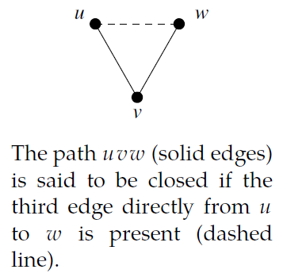
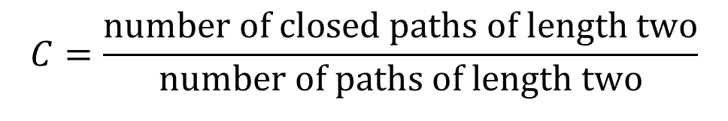
Clustering Coefficients
Definition. The clustering coefficient (sometimes called the global clustering coefficient) of a graph is the fraction of paths of length two that are closed:
$$C=\frac{\text{number} \text{of} \text{closed} \text{paths} \text{of} \text{length} \text{two}}{\text{number} \text{of} \text{paths} \text{of} \text{length} \text{two}}$$
Thus, the clustering coefficient can be thought of as probability that two people with a common friend are themselves friends.

Slide 12
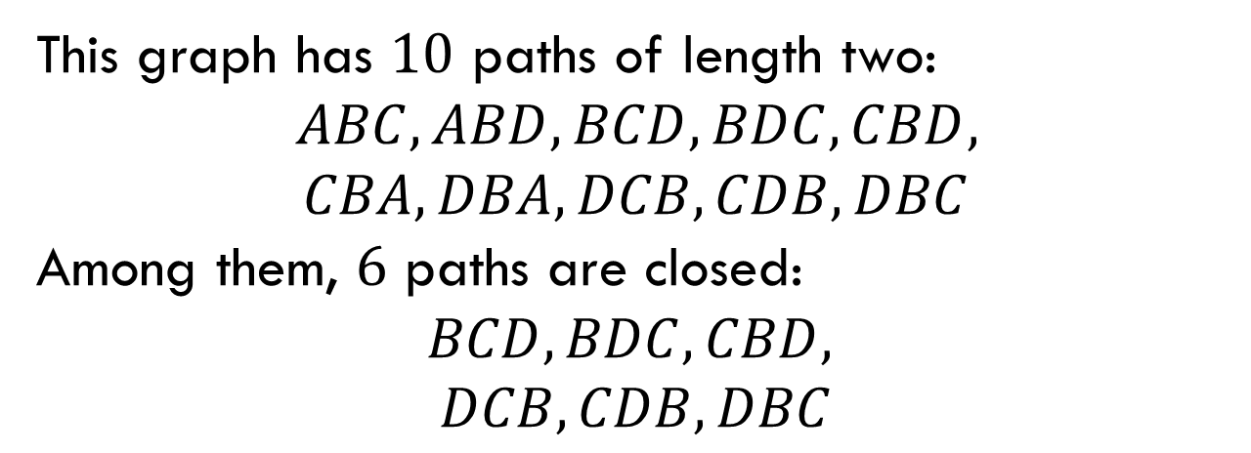
Example
This graph has $10$ paths of length two:
$ABC, ABD, BCD, BDC, CBD,$
$$CBA, DBA, DCB, CDB, DBC$$
Among them, $6$ paths are closed:
$$BCD, BDC, CBD,$$
$$DCB, CDB, DBC$$
Therefore, the clustering coefficient of the graph is $6/{10}.$

Slide 13


Two More Examples
$$C=0.4$$
$$C=0.6$$

Slide 14
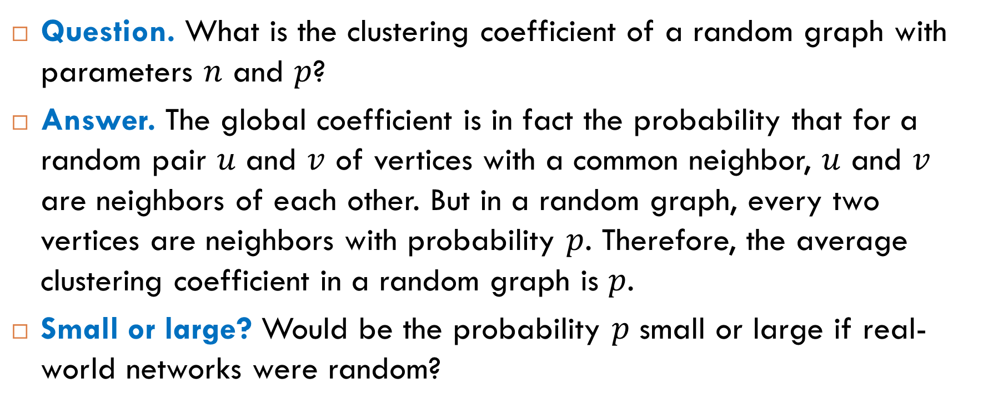
Transitivity in Random Graphs
Question. What is the clustering coefficient of a random graph with parameters $n$ and $p$?
Answer. The global coefficient is in fact the probability that for a random pair $u$ and $v$ of vertices with a common neighbor, $u$ and $v$ are neighbors of each other. But in a random graph, every two vertices are neighbors with probability $p$. Therefore, the average clustering coefficient in a random graph is $p$.
Small or large? Would be the probability $p$ small or large if real-world networks were random?

Slide 15
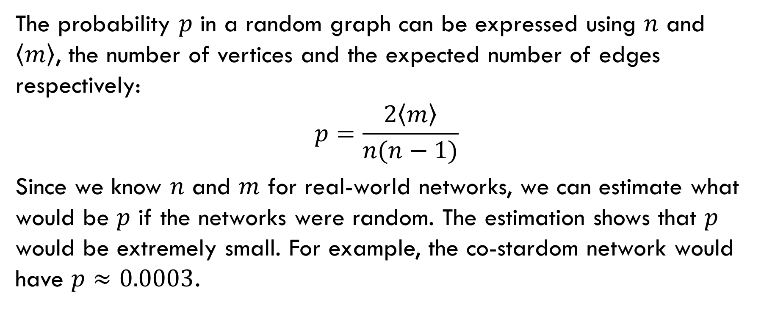
Small or Large?
The probability $p$ in a random graph can be expressed using $n$ and $\left\langle m\right\rangle$, the number of vertices and the expected number of edges respectively:
$$p=\frac{2\left\langle m\right\rangle }{n(n−1)}$$
Since we know $n$ and $m$ for real-world networks, we can estimate what would be $p$ if the networks were random. The estimation shows that $p$ would be extremely small. For example, the co-stardom network would have $p≈0.0003$.

Slide 16
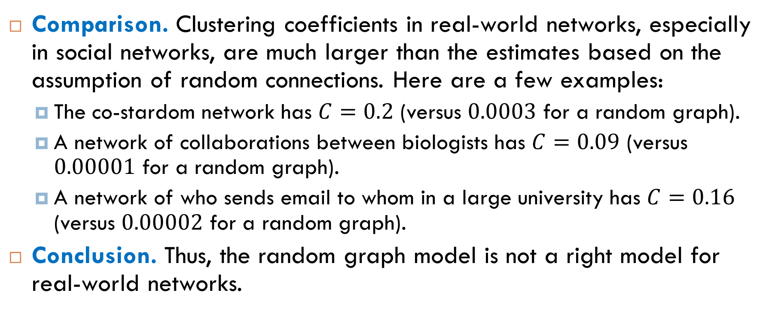
Transitivity in Real-World Networks
Comparison. Clustering coefficients in real-world networks, especially in social networks, are much larger than the estimates based on the assumption of random connections. Here are a few examples:
The co-stardom network has $C=0.2$ (versus $0.0003$ for a random graph).
A network of collaborations between biologists has $C=0.09$ (versus $0.00001$ for a random graph).
A network of who sends email to whom in a large university has $C=0.16$ (versus $0.00002$ for a random graph).
Conclusion. Thus, the random graph model is not a right model for real-world networks.

Slide 17
Local Clustering Coefficients

Slide 18
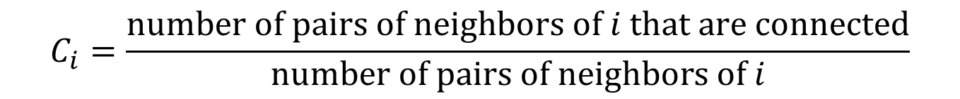
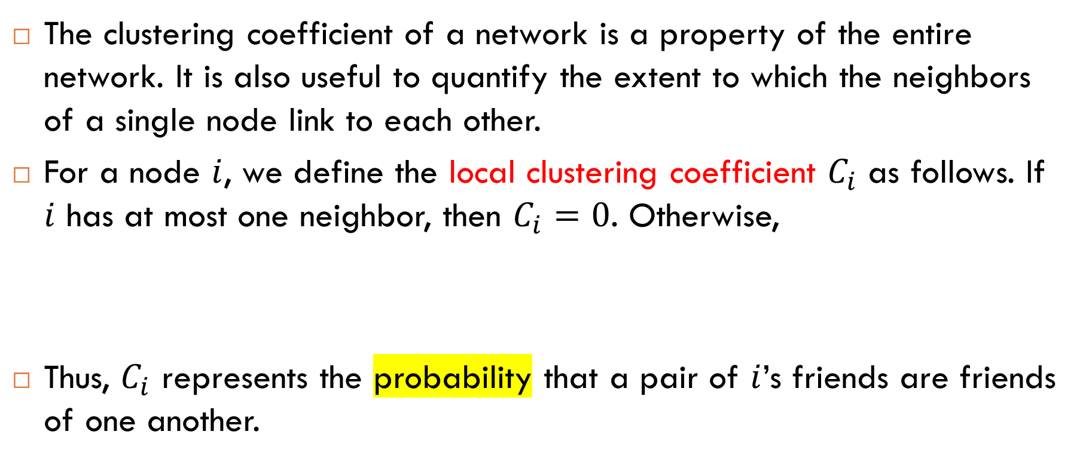
Local Clustering Coefficients
The clustering coefficient of a network is a property of the entire network. It is also useful to quantify the extent to which the neighbors of a single node link to each other.
For a node $i$, we define the local clustering coefficient $C_{i}$ as follows. If $i$ has at most one neighbor, then $C_{i}=0$. Otherwise,
Thus, $C_{i}$ represents the probability that a pair of $i$’s friends are friends of one another.
$$C_{i}=\frac{\text{number} \text{of} \text{pairs} \text{of} \text{neighbors} \text{of} i \text{that} \text{are} \text{connected}}{\text{number} \text{of} \text{pairs} \text{of} \text{neighbors} \text{of} i}$$

Slide 19
Example

Slide 20
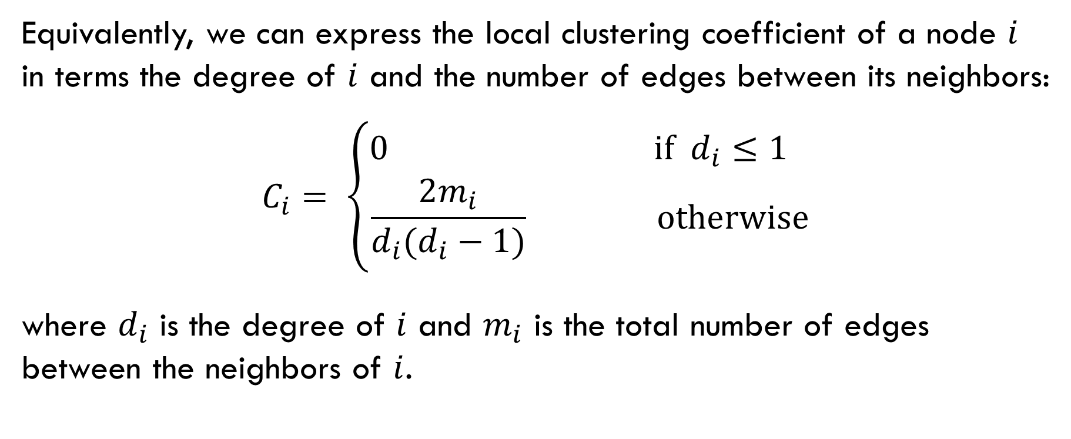
Equivalent Definition
Equivalently, we can express the local clustering coefficient of a node $i$ in terms the degree of $i$ and the number of edges between its neighbors:
$$C_{i}= \left\{\begin{aligned}0 \text{if} d_{i}≤1 \\ \frac{2m_{i}}{d_{i}(d_{i}−1)} \text{otherwise}\end{aligned}\right.$$
where $d_{i}$ is the degree of $i$ and $m_{i}$ is the total number of edges between the neighbors of $i$.

Slide 21

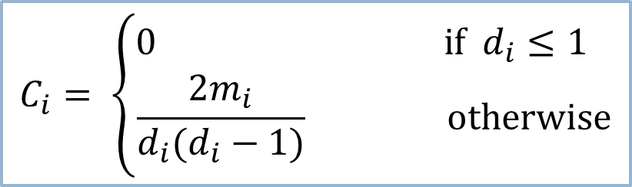
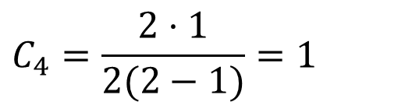
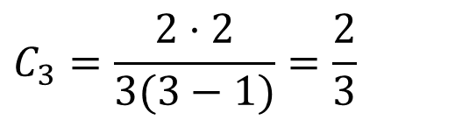
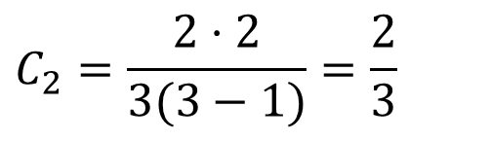
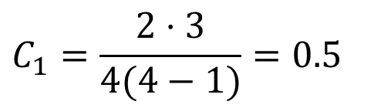
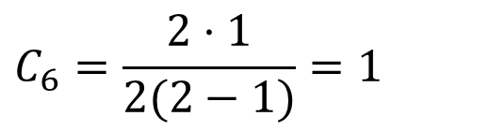
Example
$$C_{1}=\frac{2⋅3}{4(4−1)}=0.5$$
$$C_{3}=\frac{2⋅2}{3(3−1)}=\frac{2}{3}$$
$$C_{2}=\frac{2⋅2}{3(3−1)}=\frac{2}{3}$$
$$C_{4}=\frac{2⋅1}{2(2−1)}=1$$
$$C_{5}=0$$
$$C_{i}= \left\{\begin{aligned}0 \text{if} d_{i}≤1 \\ \frac{2m_{i}}{d_{i}(d_{i}−1)} \text{otherwise}\end{aligned}\right.$$
$$C_{6}=\frac{2⋅1}{2(2−1)}=1$$

Slide 22

Question
In many networks, especially in social networks, local clustering is strongly correlated with betweenness. Which of the following holds?
For a node $i,$ the higher the clustering coefficient of $i$ is, the higher the betweenness of $i$ is.
For a node $i,$ the lower the clustering coefficient of $i$ is, the higher the betweenness of $i$ is.
If two of your friends are not connected directly and their information about one another comes via their mutual connection with you, then you can control the flow of that information.

Slide 23
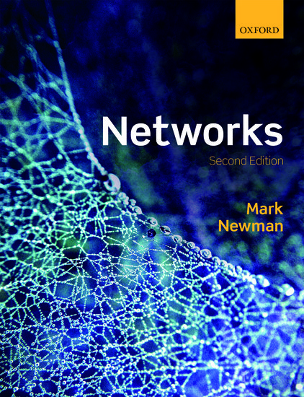
Reading
Section 7.3

